Slide 1
Reconfiguring the Kernel
Version A.01
H3064S Module 18 Slides

Slide 2
Why Reconfigure the Kernel?
Reasons for reconfiguring:
To add or remove device drivers
To add or remove subsystems
To modify system parameters
Methods for reconfiguring:
SAM
HP-UX commands
a66992

Slide 3
Static Kernel Modules
vmunix
vmunix
Recompile a new kernel with a tape driver.
tape
vmunix
tape
Memory
Reboot!
/stand
New kernel and driver are loaded in memory after reboot.
vmunix
tape
vmunix
tape
Memory
/stand
a66993

Slide 4
Dynamic Kernel Modules
vmunix
vmunix
d
Memory
No Reboot!
/stand
New driver loaded in memory without rebooting!
vmunix
vmunix
d
d
Memory
/stand
a66994

Slide 5
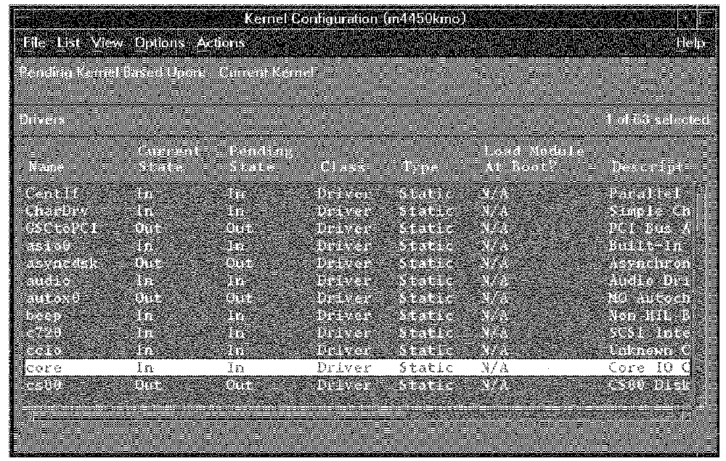
Using SAM for Kernel Configuration
a64924

Slide 6
Moving the New Kernel into Place
/stand
build
vmunix_test
vmunix
vmunix.prev
dlkm.vmunix_test
dlkm
dlkm.vmunix.prev
system.sam
system
system.prev
a66995

Slide 7
What If the New Kernel Won't Boot?
Call
/stand/vmunix.prev
a538161

